Slide 1
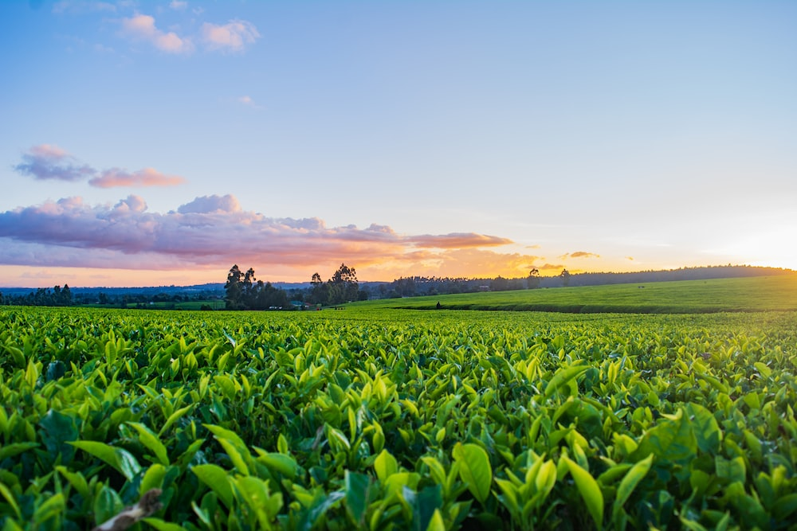
PlantPathoDetect System
Focuses on Deecting diseases in maize, Tomato and Potato

Slide 2
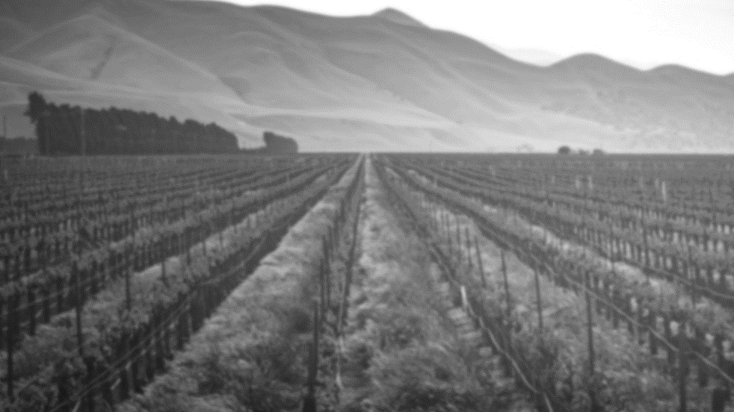
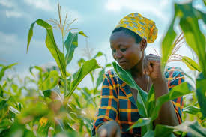
Client BackGround
Smallholder and commercial farmers struggling with crop disease management.
Research institutions seeking innovative agricultural solutions.
Agricultural extension officers aiding farmers in disease diagnosis.
Policymakers and NGOs promoting food security and sustainable practices..

Slide 3
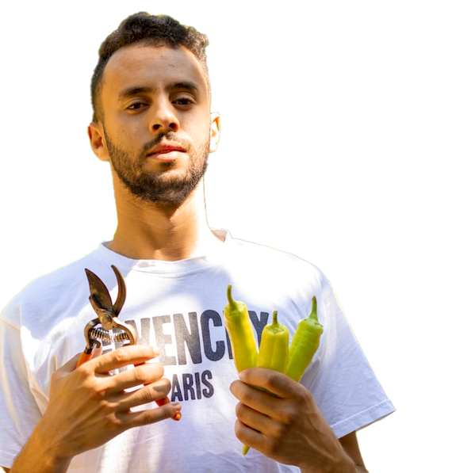
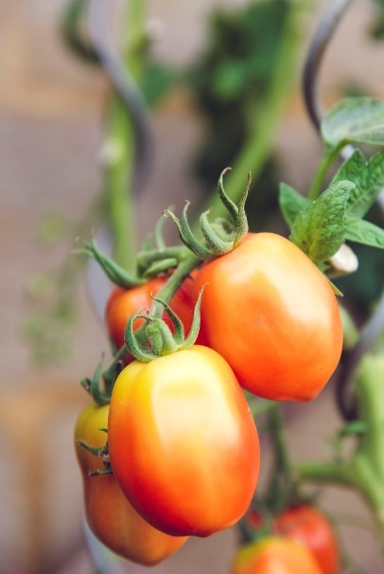
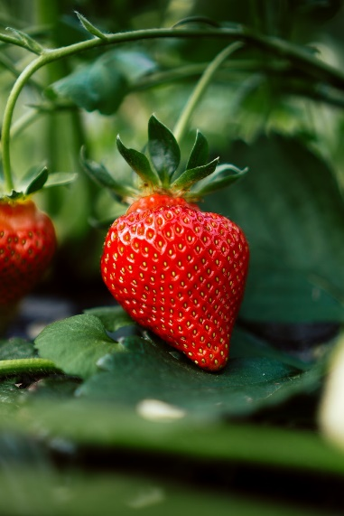
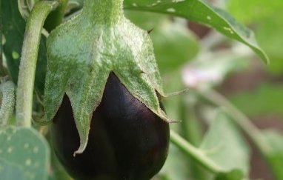
Problems
Essential crops like maize, potatoes, and tomatoes face increasing threats from diseases, reducing yields.
Rising crop diseases lead to economic strain, food shortages, and challenges for farmers’ livelihoods.
Lack of early disease detection hampers timely intervention, risking crop damage and food production sustainability.

Slide 4





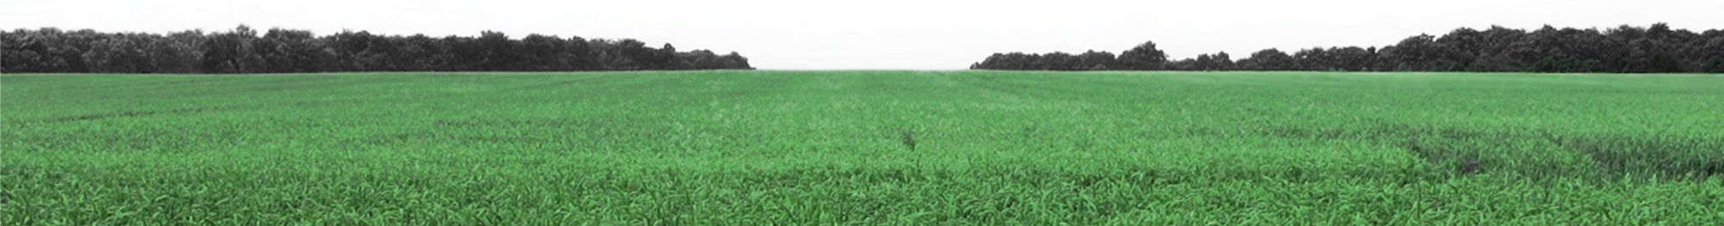
Proposed Solutions
Step 1
Step 2
Step 3
Machine Learning Model: Develop a CNN to classify crop diseases in maize, potatoes, and tomatoes.
Web Platform: Create a user-friendly web app for real-time crop disease analysis and treatment recommendations..
Data Collection: Build a diverse crop image dataset for improved disease detection.

Slide 5
Objectives
Objectives 1
Objectives 3
Data Collection: Collect and preprocess a diverse crop disease image dataset.
Model Development: Design and train a CNN for accurate disease classification.
Objectives 2
Objectives 4
Application Deployment: Deploy the trained model in a user-friendly web app.
System Evaluation: Evaluate the model's performance and refine based on user feedback.

Slide 6
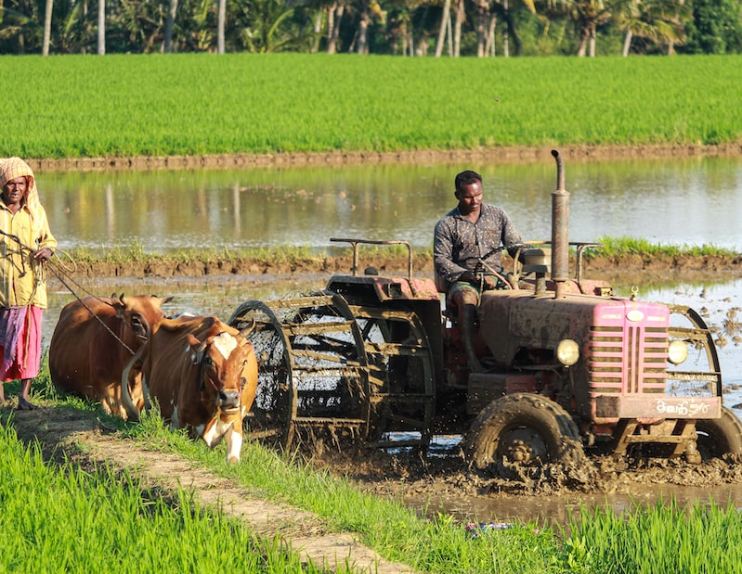
Methodology and Data Collection
-
Data Collection
I got the Data from PlantVillage that Contain Images for The diseases of different plants.
Images of maize, potatoes, and tomatoes affected by specific diseases
Methology Used:
Data Processing
Model Selection
Training Process
Data Cleaning
Evaluation metrics
Deployment

Slide 7
Project Management Tools
I used Trello Board for Tracking my project
Trello https://trello.com/b/Ms5kLY4f/plantpathodetect

Slide 8
THANK YOU

Slide 9
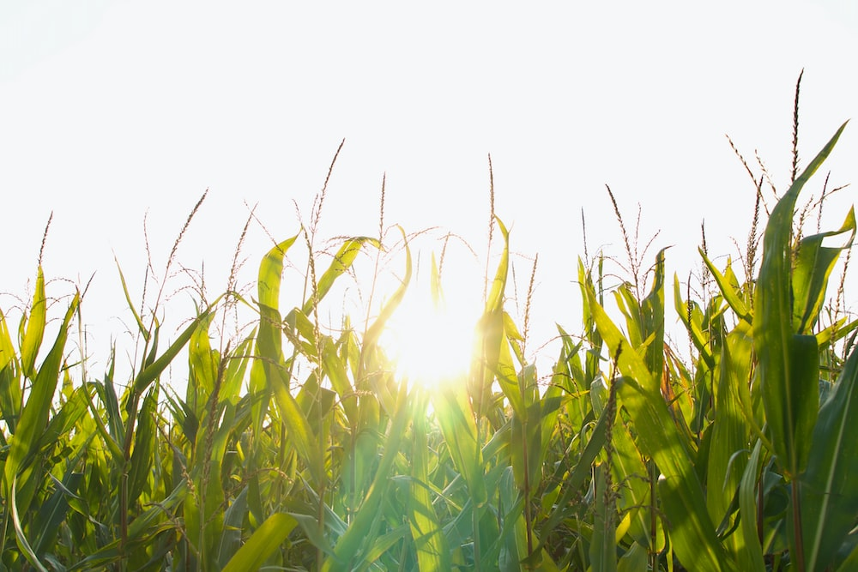
CONTENTS
01
Your title here
Briefly describe the concept.
02
Your title here
Briefly describe the concept.
03
Your title here
Briefly describe the concept.
04
Your title here
Briefly describe the concept.

Slide 10
Your title here
Objectives 1
Presentations are communication tools that can be used as speeches, reports, and more.
Objectives 2
Presentations are communication tools that can be used as speeches, reports, and more.
Presentations are communication tools that can be used as demonstrations, lectures, speeches, reports, and more. Most of the time, they're presented before an audience.

Slide 11
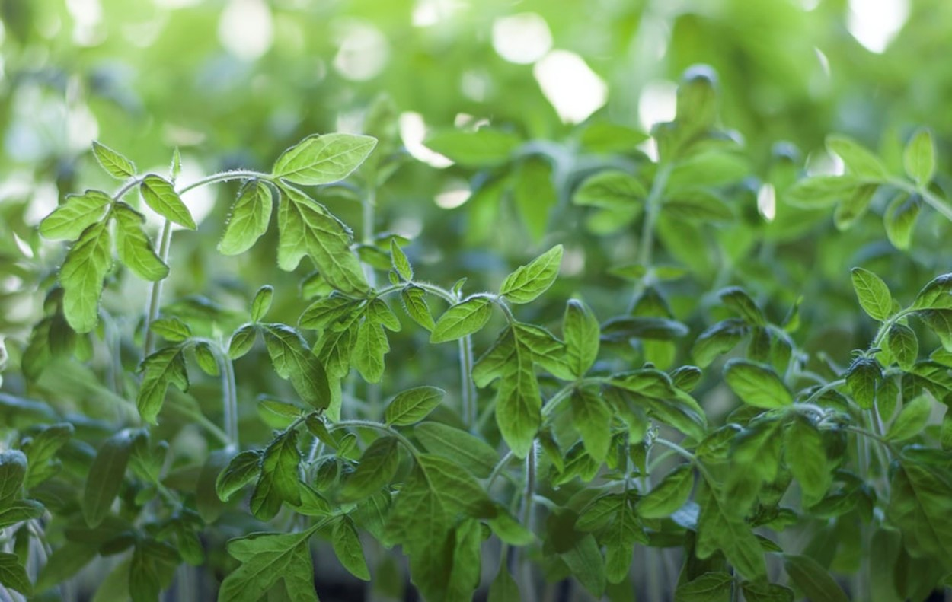
02
Your title here
Briefly describe the concept.

Slide 12
Your title here
Objectives 1
Presentations are communication tools that can be used as speeches, reports, and more.
Objectives 2
Presentations are communication tools that can be used as speeches, reports, and more.
Presentations are communication tools that can be used as demonstrations, lectures, speeches, reports, and more. Most of the time, they're presented before an audience.

Slide 13
03
Your title here
Briefly describe the concept.

Slide 14
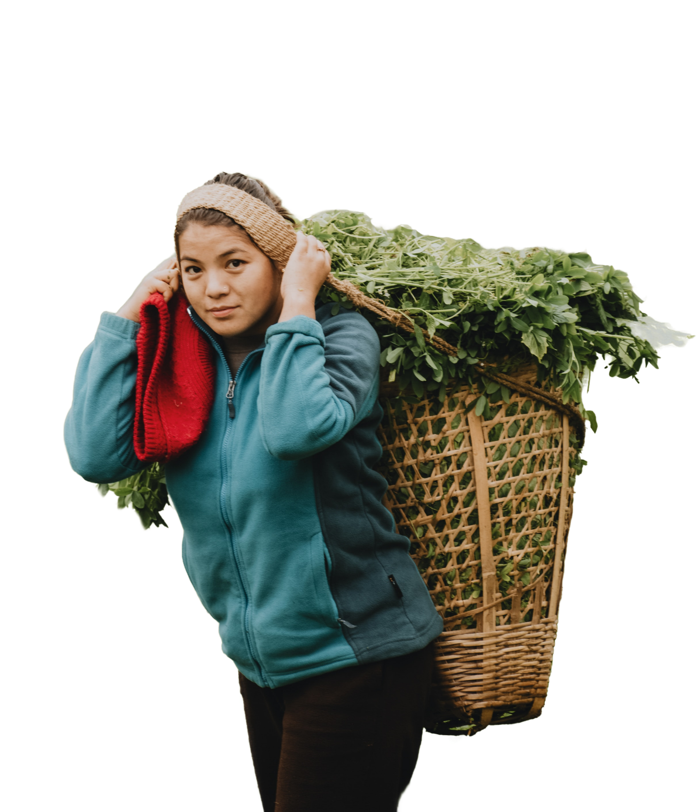
Your title here
Objectives 1
Presentations are communication tools.
Objectives 2
Presentations are communication tools.
Objectives 3
Presentations are communication tools.
Objectives 4
Presentations are communication tools.

Slide 15
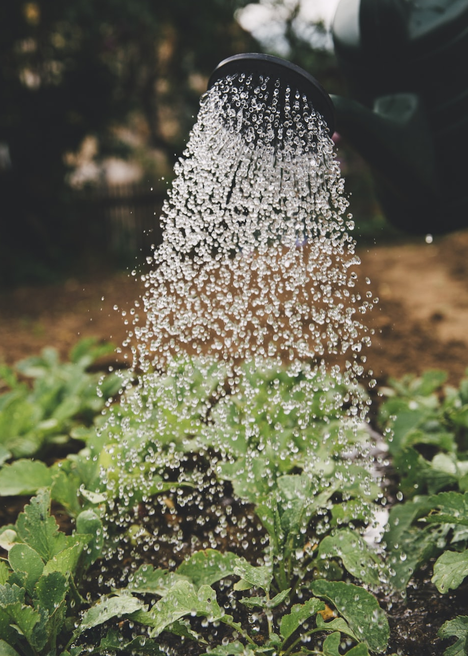
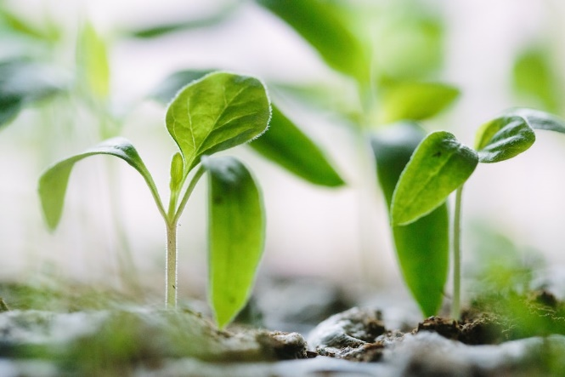
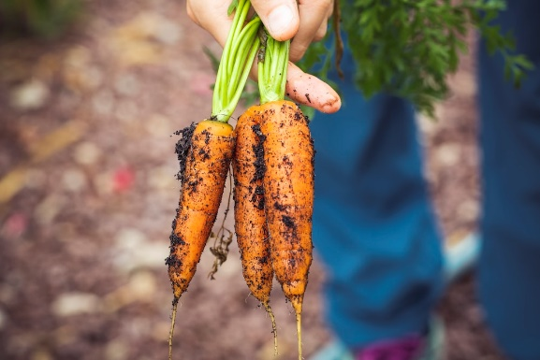
Your title here
Presentations are communication tools that can be used as speeches, reports, and more.
01
Presentations are communication tools that can be used as speeches, reports, and more.
02

Slide 16
Your title here
Objectives 1
Objectives 2
Objectives 3
Presentations are communication tools that can be used as speeches, reports, and more.
Presentations are communication tools that can be used as speeches, reports, and more.
Presentations are communication tools that can be used as speeches, reports, and more.

Slide 17
04
Your title here
Briefly describe the concept.

